Slide 1
College of Western Idaho SWDV 210 Introduction to Server Side Programming
Lab – Working with Dates

Slide 2
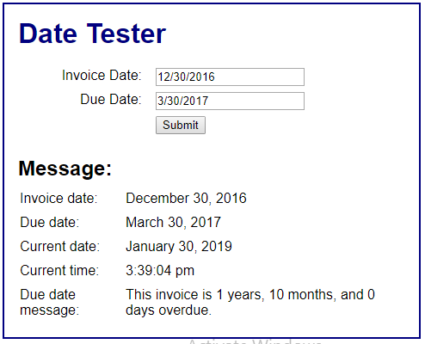
Lab – Working with Dates
Complete Exercise 10-1 on page 311
Set the current timezone so that the current time matches Boise time
Post the link to your application in BB under Daily Labs, Wk3Day3 along with the link to your page from Part B & submit
Expected output:

